Slide 1
Cybersecurity
Router and Switch Security

Slide 2

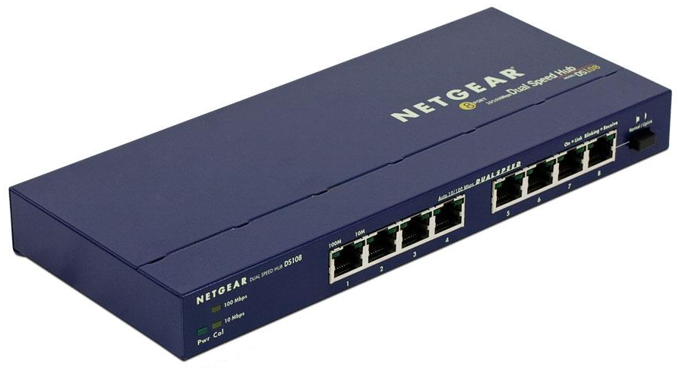
Hub
Layer 1 device
Replicates packets to all ports
No logic involved
Simple, unsophisticated
Does not segment network
Allows for many problems
Broadcast storms
Packet collisions
Network snooping
Hard to find, most devices are switches now

Slide 3
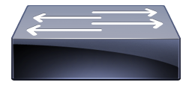
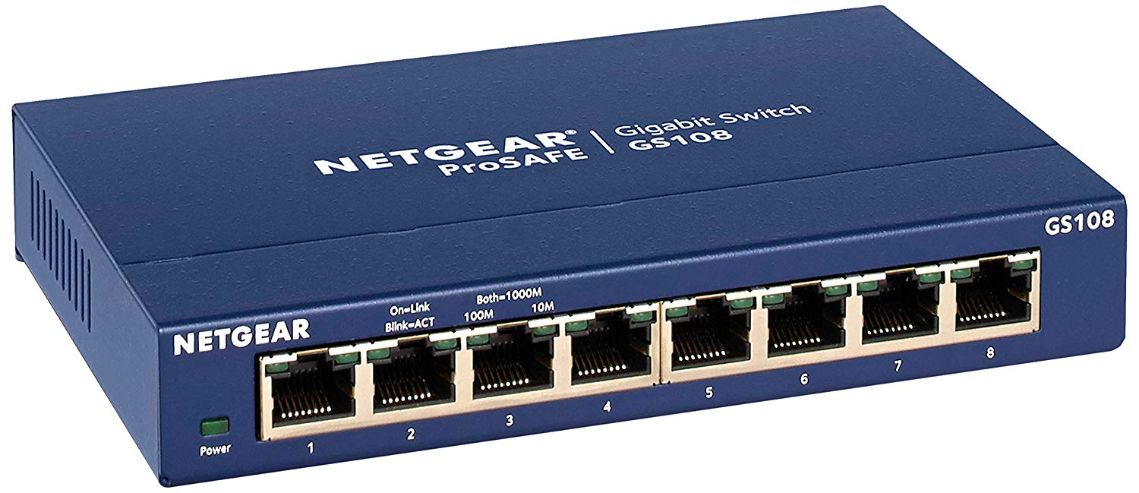
Switches
Layer 2 device
Forwards traffic based on MAC address
Create/store MAC address tables
Physically similar to a hub
Functionally smarter
Many ports
High throughput

Slide 4

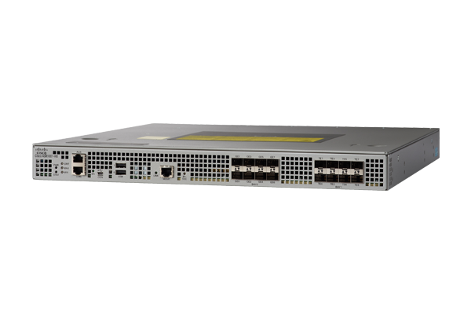
Routers
Layer 3 Device
Routes traffic between networks
Often connects differing network types
LAN, WAN, copper, fiber, wireless
Directs traffic based on IP address (Layer 3)

Slide 5

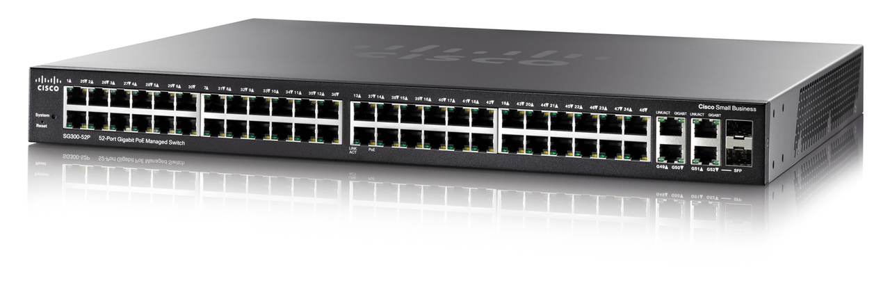
Layer 3 Switch
Router and switch together in one box
Switching still happens at OSI Layer 2
Routing still happens at OSI Layer 3
Just one box for easier deployment

Slide 6

Access Control Lists (ACLs)
Rules to allow or deny traffic
Also used for NAT, QoS, IDS/IPS, etc.
Defined for Incoming or Outgoing ports
ACLs evaluate certain criteria
Source IP, Destination IP, TCP port, UDP port, ICMP

Slide 7



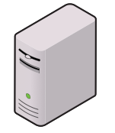
Configuring an ACL
192.168.0.101
192.168.1.15
192.168.0.100
192.168.1.1
192.168.0.1
192.168.1.10
192.168.1.18
192.168.0.10
192.168.1.13
192.168.0.15

Slide 8
Anti-spoofing techniques
Spoofing – using another host’s address
Anti-spoofing prevents many types of attacks
Man-in-the-middle, DDoS, etc
Detect duplicate MAC addresses/IP addresses
Filtering reserved IP addresses
Private address should not route to or from internet
Reverse Path Forwarding (RPF)
Response to inbound packet should return via same path
If not then drop the packet

Slide 9
Switch port security
Protection is usually at the perimeter
Once inside, network is largely wide open
Often easy to get on the network
Lobby, conference rooms, public meeting spaces
Protect (and limit) those connections routes
Disable network ports not in use
Disable network drops not in use
Monitor wireless range
Use minimum power necessary

Slide 10
Network Access Control (NAC)
IEEE 802.1X – Port-based Network Access Control
Users must authenticate to get on network
Use of EAP and RADIUS
EAP - Extensible Authentication Protocol
RADIUS - Remote Authentication Dial-In User Service
Disable network ports not in use (physical ports)
Check for duplicate MAC addresses

Slide 11
Loop Prevention
Connect two switches to each other
Each will send broadcast traffic back and forth forever
“That MAC isn’t here, I’m passing it on.” “That MAC isn’t here, I’m passing it on.” “That MAC isn’t here, I’m passing it on.” “That MAC isn’t here, I’m passing it on.”
Layer 2 has no “counting” mechanism for hops
Easy way to bring down a network
Easy to resolve, just unplug loop
Hard to spot
Spanning Tree Protocol
IEEE Standard 802.1D
Prevents loops in switched networks
Even home networking equipment features STP

Slide 12
STP in action
Switch A
Switch D
Switch H
Switch B
Switch G
Switch X
Switch Q
Switch T

Slide 13
STP in action
Lots of loops. Unstable network. Will easily get flooded and crash.
Switch A
LOOP
Switch D
Switch H
LOOP
LOOP
Switch B
Switch G
LOOP
Switch X
Switch Q
Switch T

Slide 14
STP in action
STP seeks out other switches downstream and counts hops to that switch. Ports are disabled so no loops exist
Switch A
Switch D
Switch H
Switch B
Switch G
Switch X
Switch Q
Switch T

Slide 15
STP in action
Switch A
Switch D
Switch H
Switch B
Switch G
Switch X
Switch Q
Switch T

Slide 16
STP in action
If a link goes down, STP reactivates disabled port so service is uninterrupted.
Switch A
Switch D
Switch H
Switch B
Switch G
Switch X
Switch Q
Switch T

Slide 17
Flood guard
Limit number of MAC addresses on an interface
Only allow specific MAC addresses
Switch monitors number of unique MAC addresses
Maintains MAC address list
Port security activates after MAC limit is reached
Lock it down! (Usually disables physical port)

